Slide 1
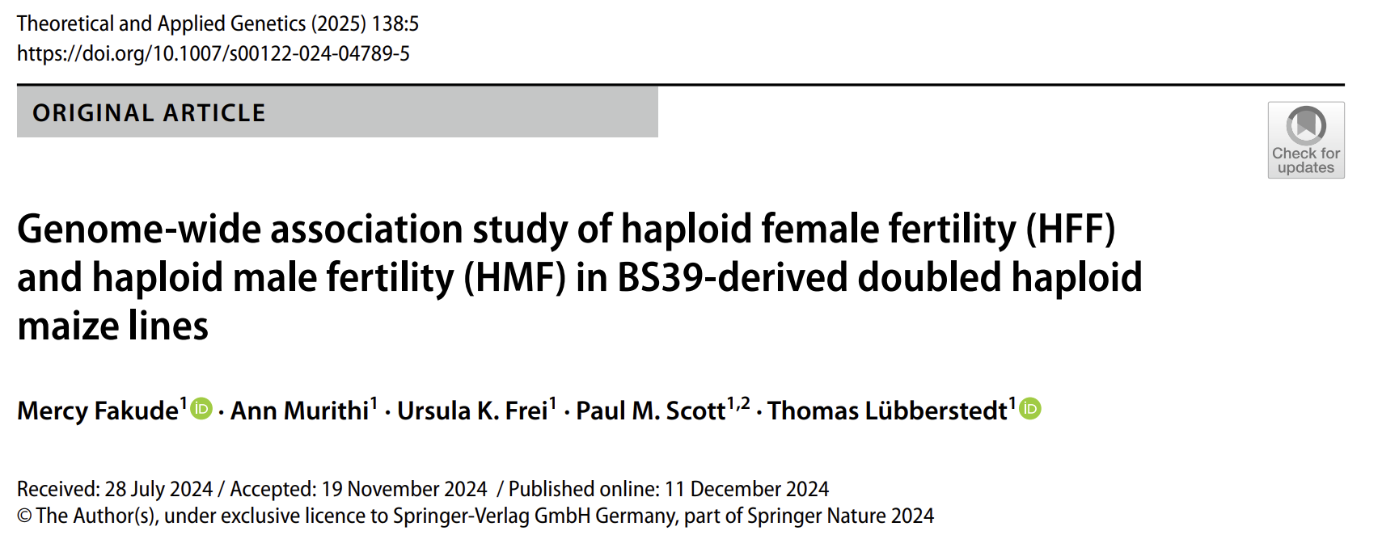
Reproducing GWAS of Haploid Fertility in Maize
Group Members
Memis Bilgici
Nazmul Hossain
Ramesh Chethri
BCB 5460, Spring 2025
May 9, 2025

Slide 2
Biological Background
Doubled Haploid breeding accelerates development of pure inbred lines.
Traditional DH breeding relies on colchicine to induce haploid genome doubling.
Colchicine is toxic, and its application is labor-intensive, with most genotypes recording low genome doubling rates (10–30%).
Investigates spontaneous haploid genome doubling (SHGD) as a safer and more efficient alternative to colchicine.

Slide 3
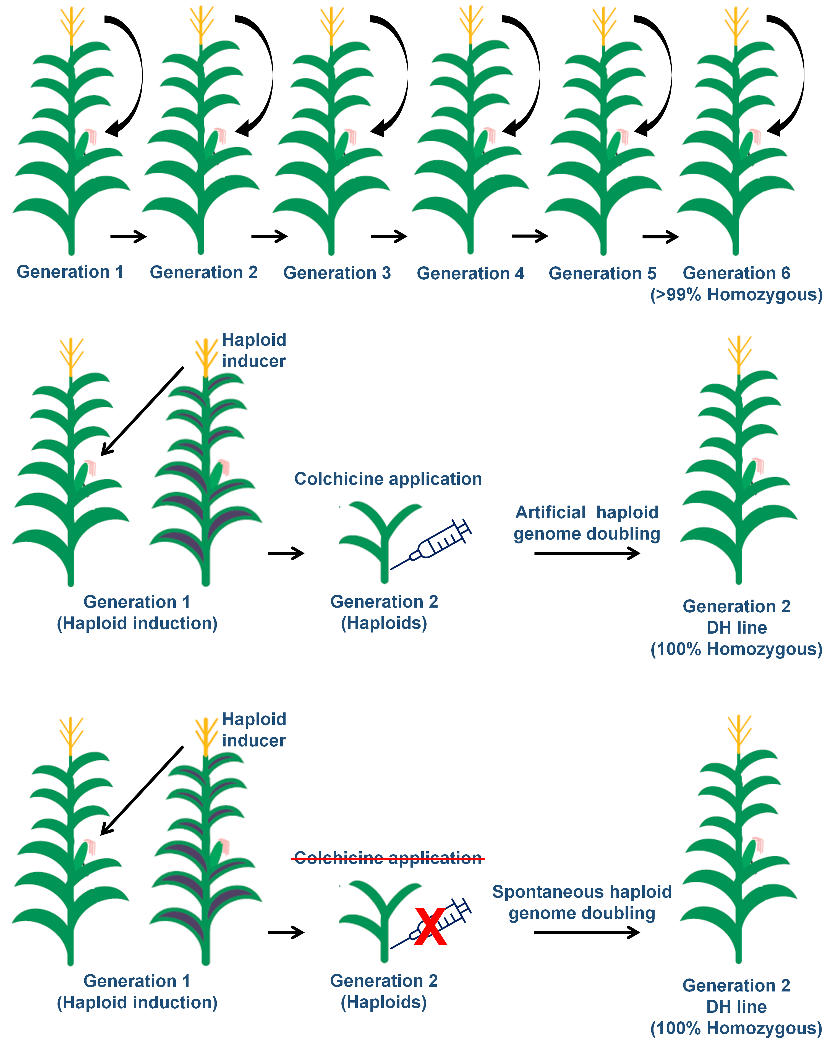
Doubled Haploid Technology Produces Completely Homozygous Plants in Two Generations
Conventional Breeding
Doubled Haploid
Technology

Slide 4
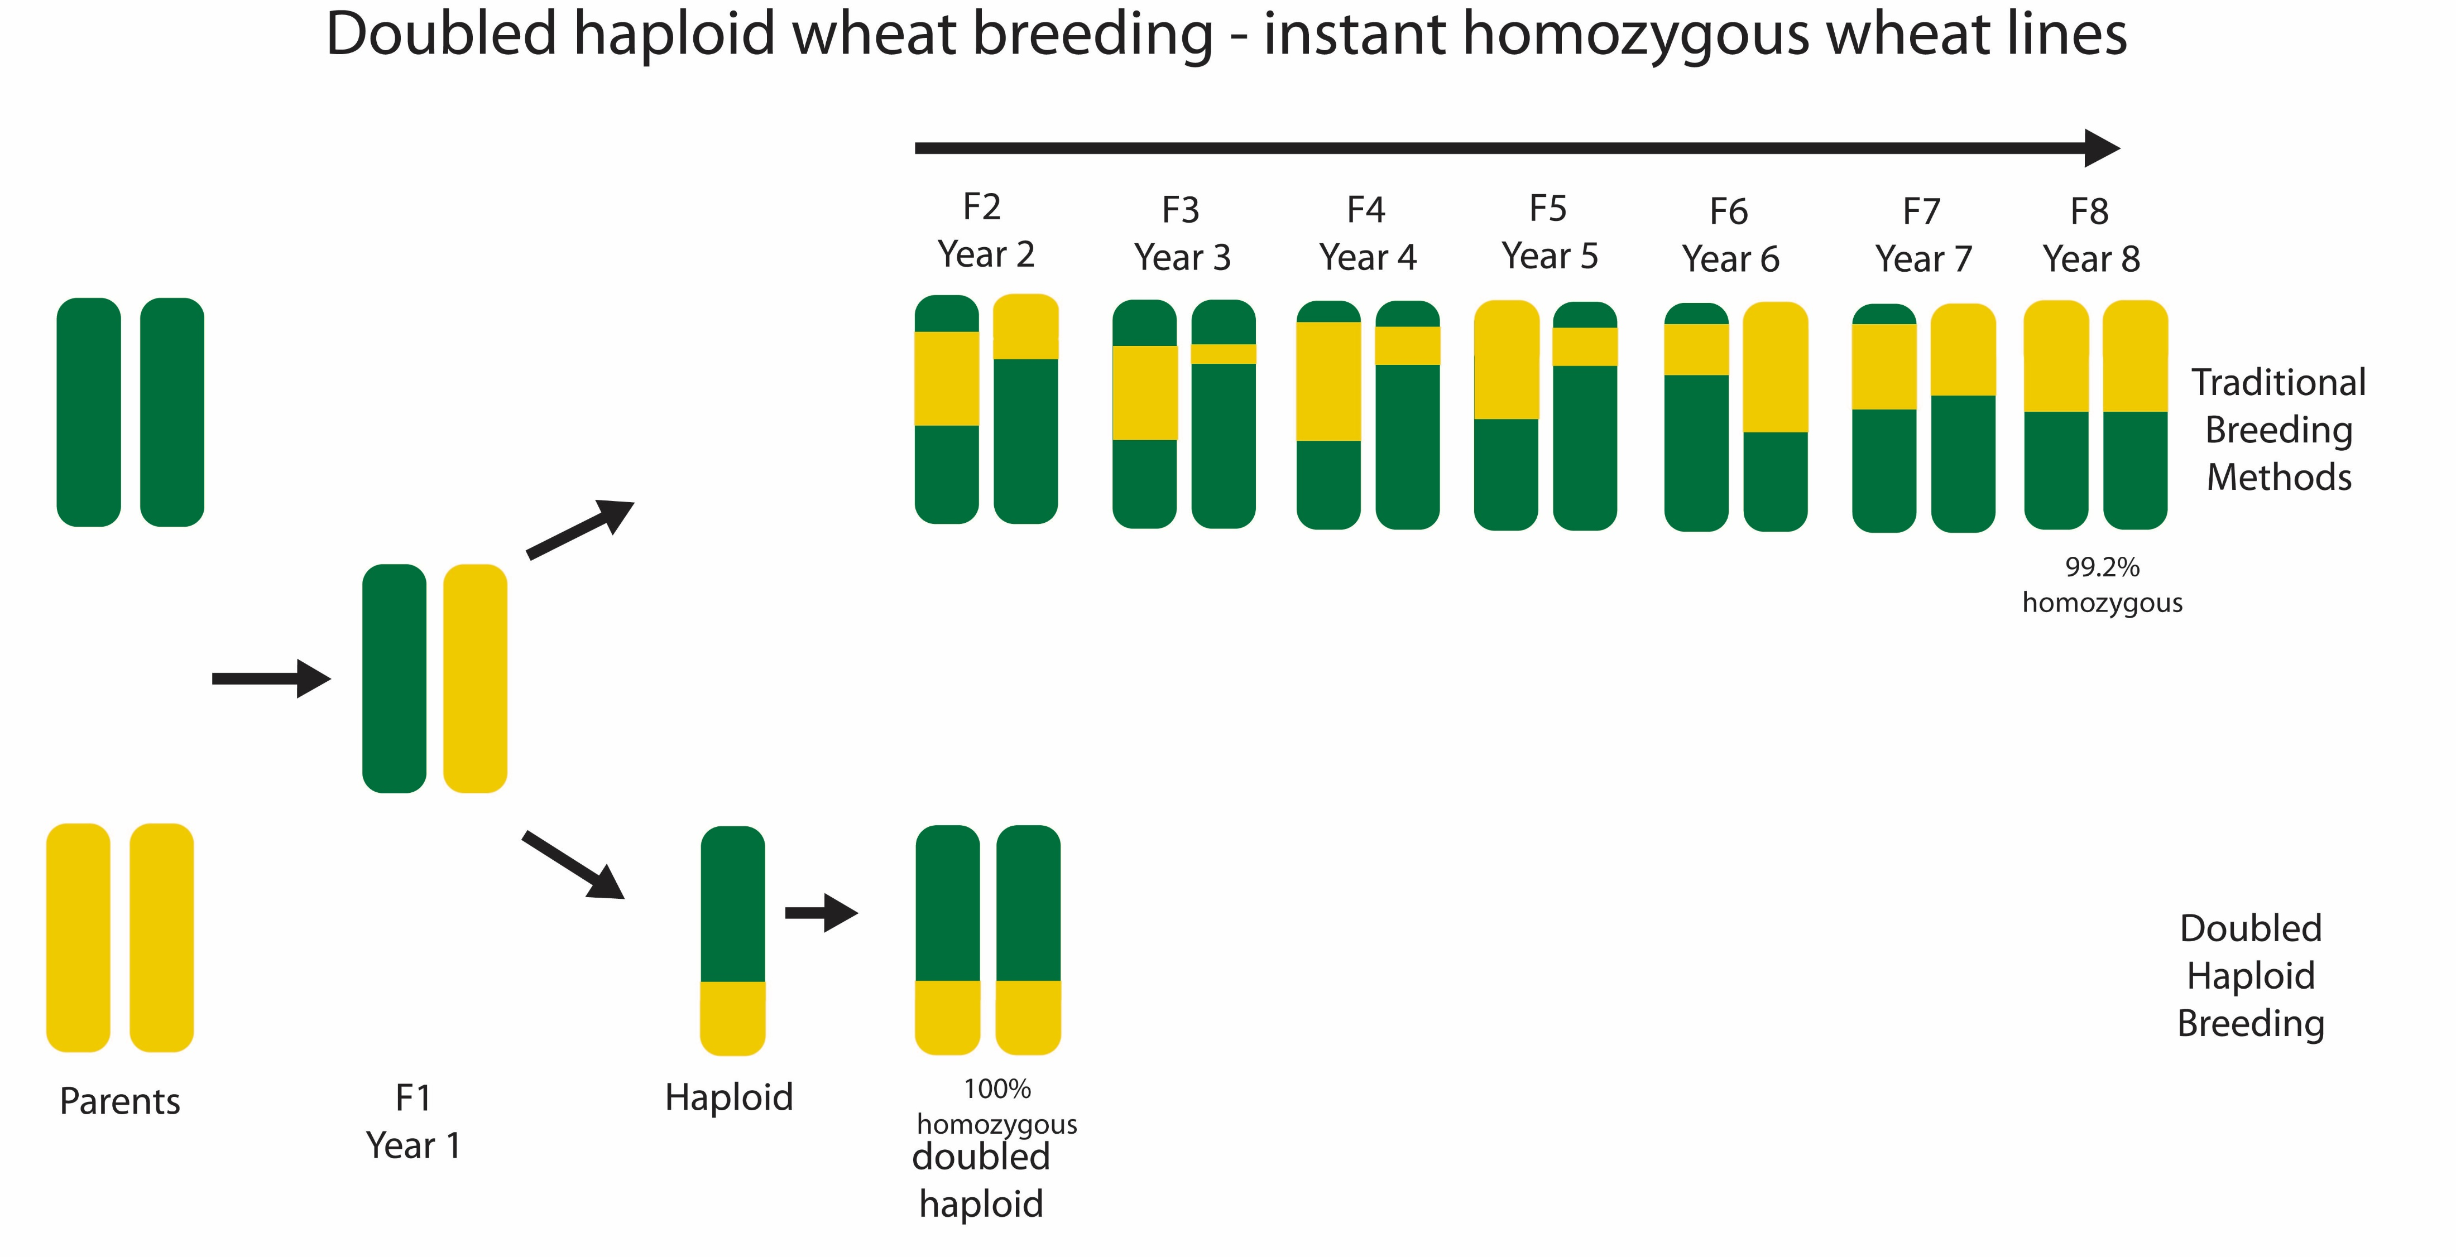

Colchicine is Required to obtain Haploid Male Fertility
Sterile male
Fertile female
Haploids
Notes:
Diploid plants are induced with a haploid inducer. Colchicine is a toxic chemical

Slide 5
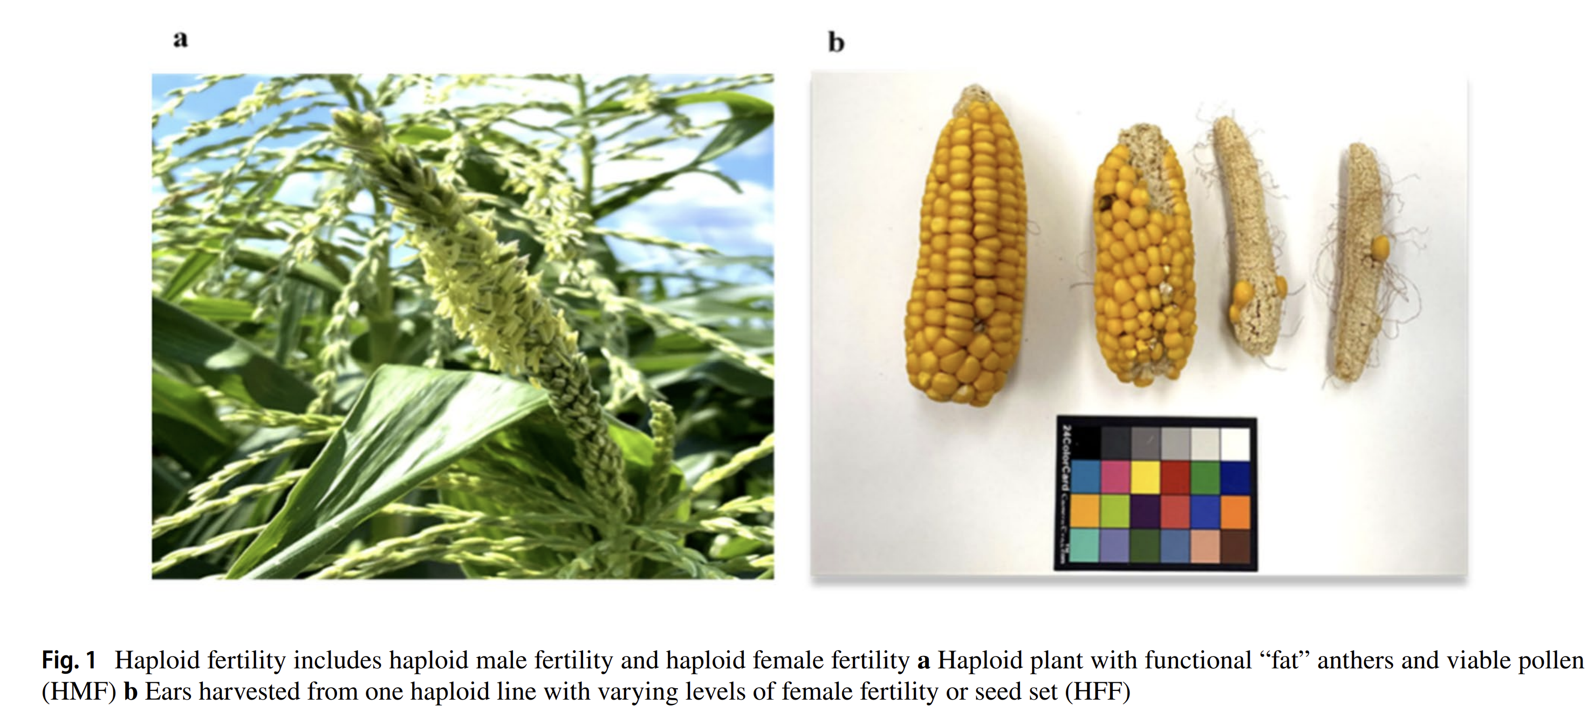
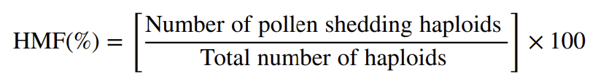
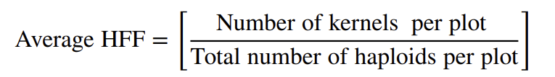
228 DH maize lines (BS39 and BS39 × A427) at Iowa State University-DH Facility
Haploid Male Fertility (HMF) and Haploid Female Fertility (HFF)
Fertility was scored on a scale from 0 (no pollen shed) to 5 (good pollen shed).
Objective:
Which genomic loci control HMF and HFF in maize?
Fakude et al. 2025 used field scores + GWAS (FarmCPU & MLM) to map these traits.
We set out to replicate their heritability estimates and SNP‐trait associations.

Slide 6
Original Study Summary
Genome‑wide association study of haploid female fertility (HFF) and haploid male fertility (HMF) in BS39‑derived doubled haploid maize lines by Fakude et al., 2025
1- 228 DH maize lines (BS39 and BS39 × A427)
2- Evaluated the effectiveness of SHGD in restoring haploid female fertility (HFF) and haploid male fertility (HMF) without colchicine.
3- Using GWAS with FarmCPU and MLMM identified genomic regions influencing HFF and HMF, significant SNP associations for both traits with candidate genes involved in cell cycle regulation, cytoskeletal organization, and hormonal signaling.
4- No correlation (r=−0.03) between HFF and HMF the two traits.
5- HFF showed high heritability (0.8) strong genetic control, whereas HMF heritability (0.5)
6- No explanation of the README file (containing just an abstract) in the GitHub; No Genotypic data provided by the author (Fakude et al., 2025).

Slide 7
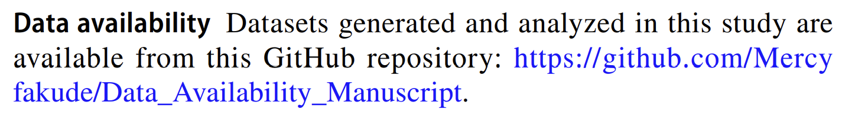
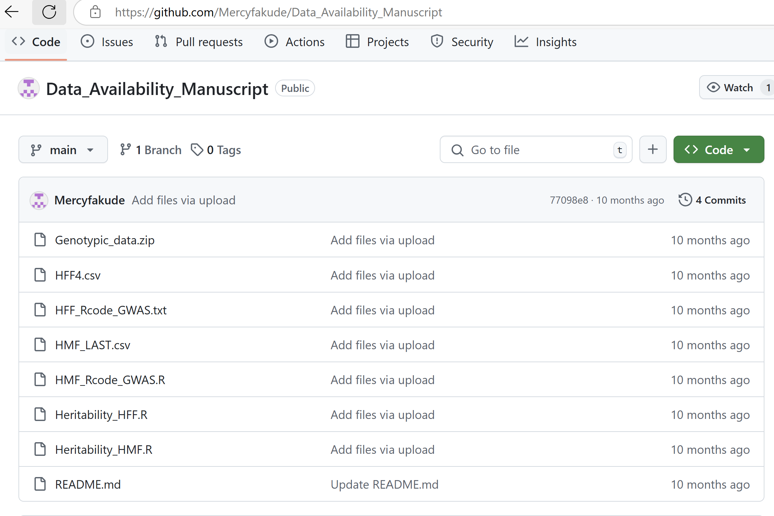

Slide 8
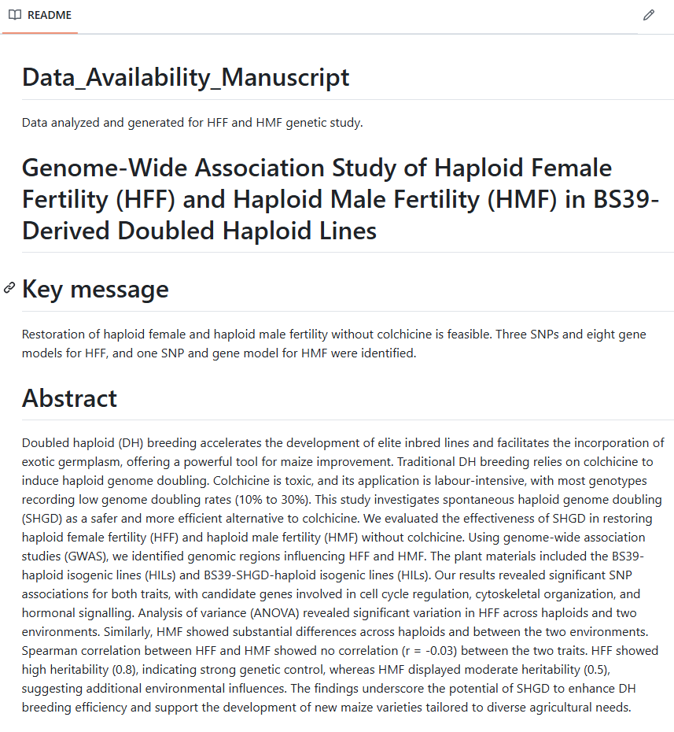

Slide 9
Workflow
Requested genotypic data from Fakude et al., 2025
Original provided code did not work we did rewrite new R code using rMVP not GAPIT.
Data cleaning and trait transformation
rMVP GWAS with FarmCPU (to control false positives) and MLM with Bonferroni correction (p-value adjusting)
Visualization (Manhattan, QQ)
BLUE estimation (GLM/LM) to calculate fixed effects and association between phenotype and genotype data( Ex: genotype avaerages)

Slide 10
Project Documentation Overview
GitHub repository structure
• README.md: setup & directory map
• Fakude2025.md: replication narrative
• code: original & cleaned scripts
• data: phenotype & genotype links
• figures: diagnostic & GWAS plots

Slide 11
HFF Results (original)
• Distribution and BLUEs
• Significant SNPs on Chr4, Chr5, Chr10
• Candidate genes: RBR1, RopGEF9
• Manhattan and QQ plots
HMF Results (original)
• Trait modeling and BLUEs
• Significant SNP on Chr1
• Candidate gene: GNAT/HLS1
• Manhattan and QQ plots

Slide 12
Results Comparison
Method | Trait | Chromosome | -log10(p) | p-value | Published?
Original Paper GAPIT | HFF | 4-5-10 | 7.1 | 8.0×10⁻⁸ | Yes
Our FarmCPU/MLM | HFF | 1-2-5-10 | 6.5 | 3.2×10⁻⁷ | Partial
Original Paper GAPIT | HMF | 1 |  |  | Yes
Our FarmCPU/MLM | HMF | Nothing |  |  | No

Slide 13
Comparison to Published Results
• We used rMVP with and FARMCPU and MLMM vs GAPIT was used in the paper
• SNP positions match Chromosome 5, 10 not all
• Gene regions align with published candidates
Visualization and annotation consistency

Slide 14
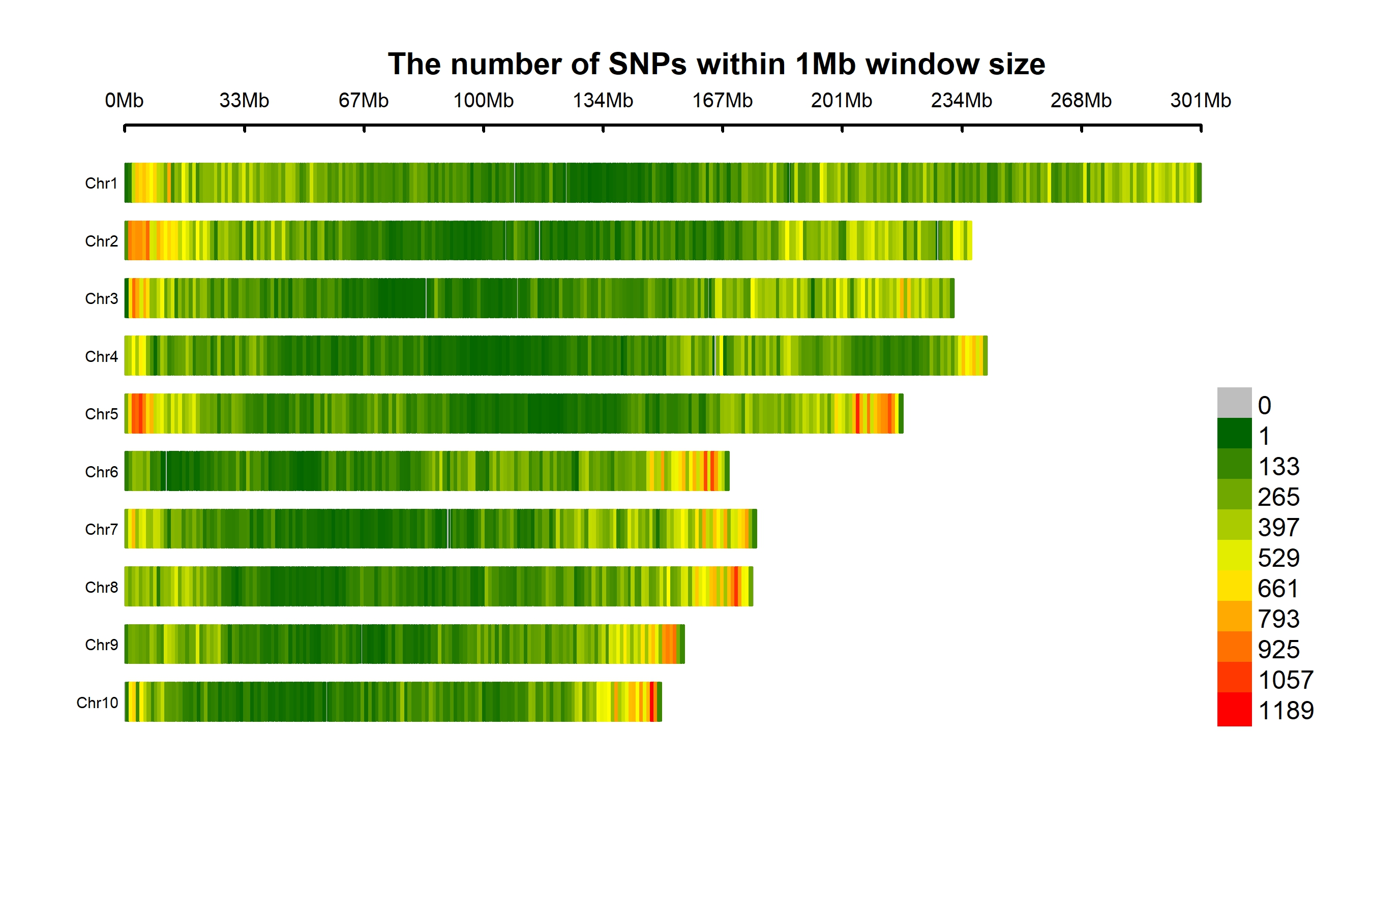
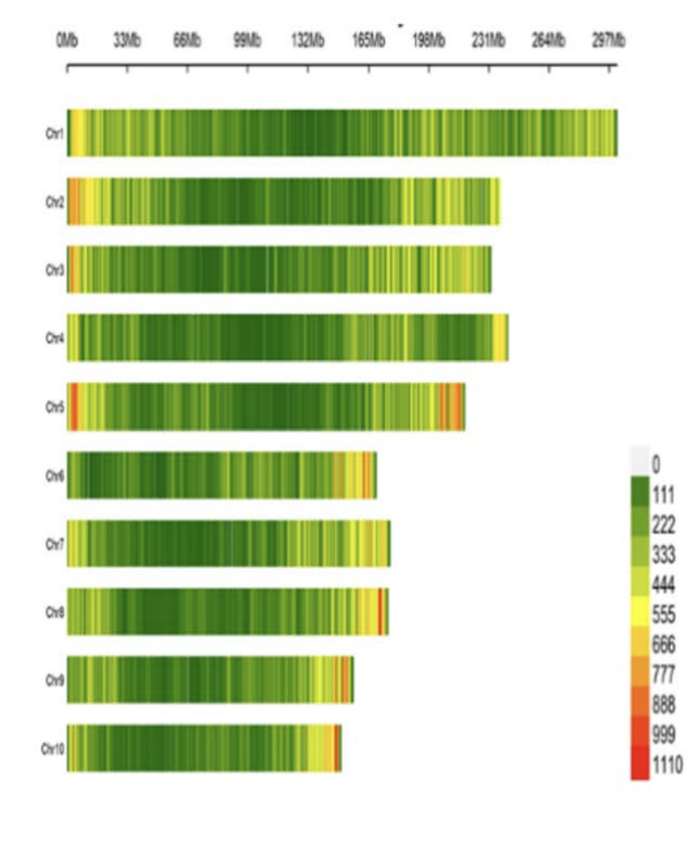
Original paper vs Our finding
The SNP density plot shows marker density in each chromosome, where green to red indicates low to high marker density.

Slide 15
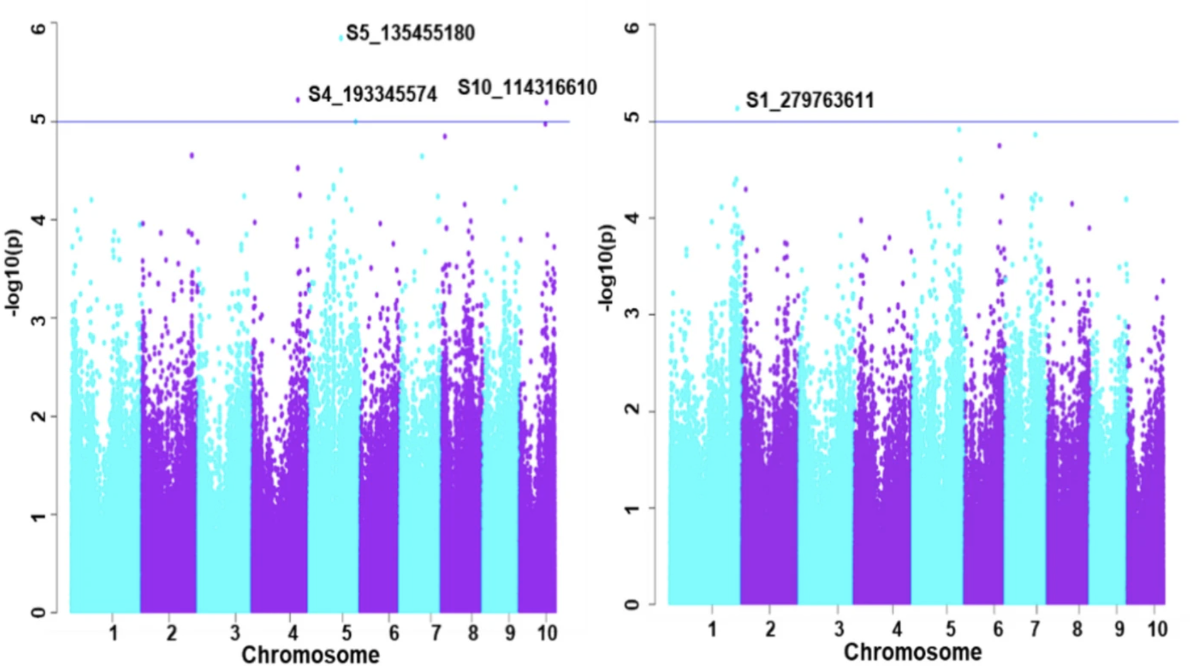
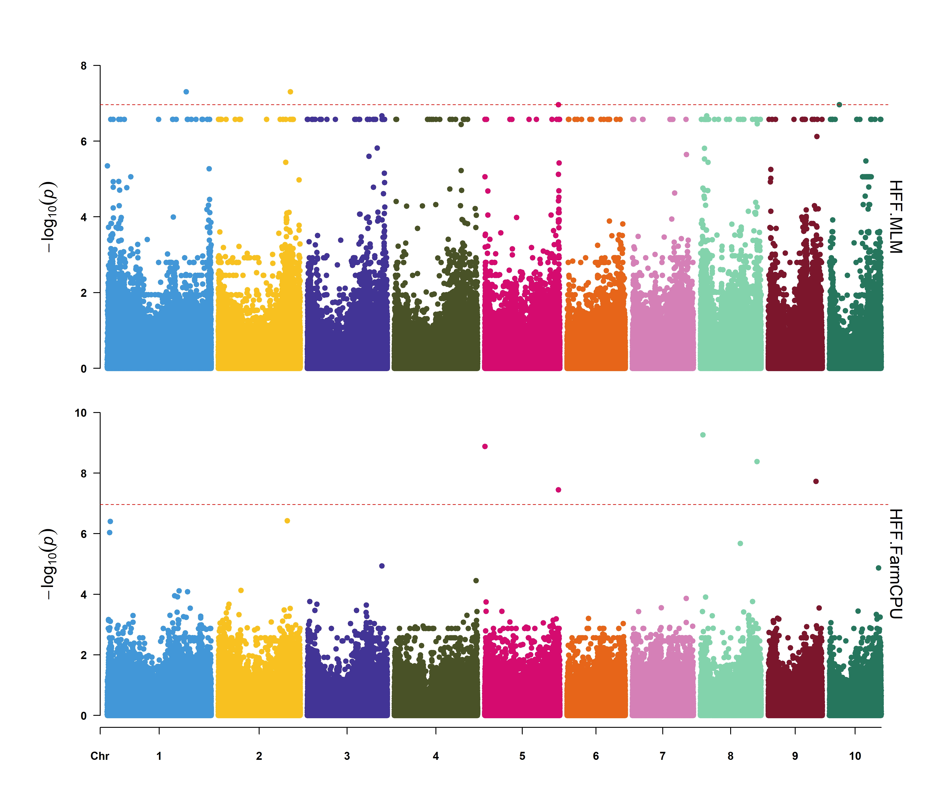
Original paper for HFF vs Our finding
The Manhattan plot highlights the three most significant SNPs in chromosomes 4, 5, and 10 for HFF.
The Y-axis represents the − log10 P-value and the X-axis represents the chromosomes.
The blue line represents the Simple M-corrected significance threshold
Our Manhattan plot shows the most significant SNPs in chromosomes 1,2,5,10 for HFF in MLM
In FARMCPU, SNPs in chromosomes 5, 8, 9.

Slide 16
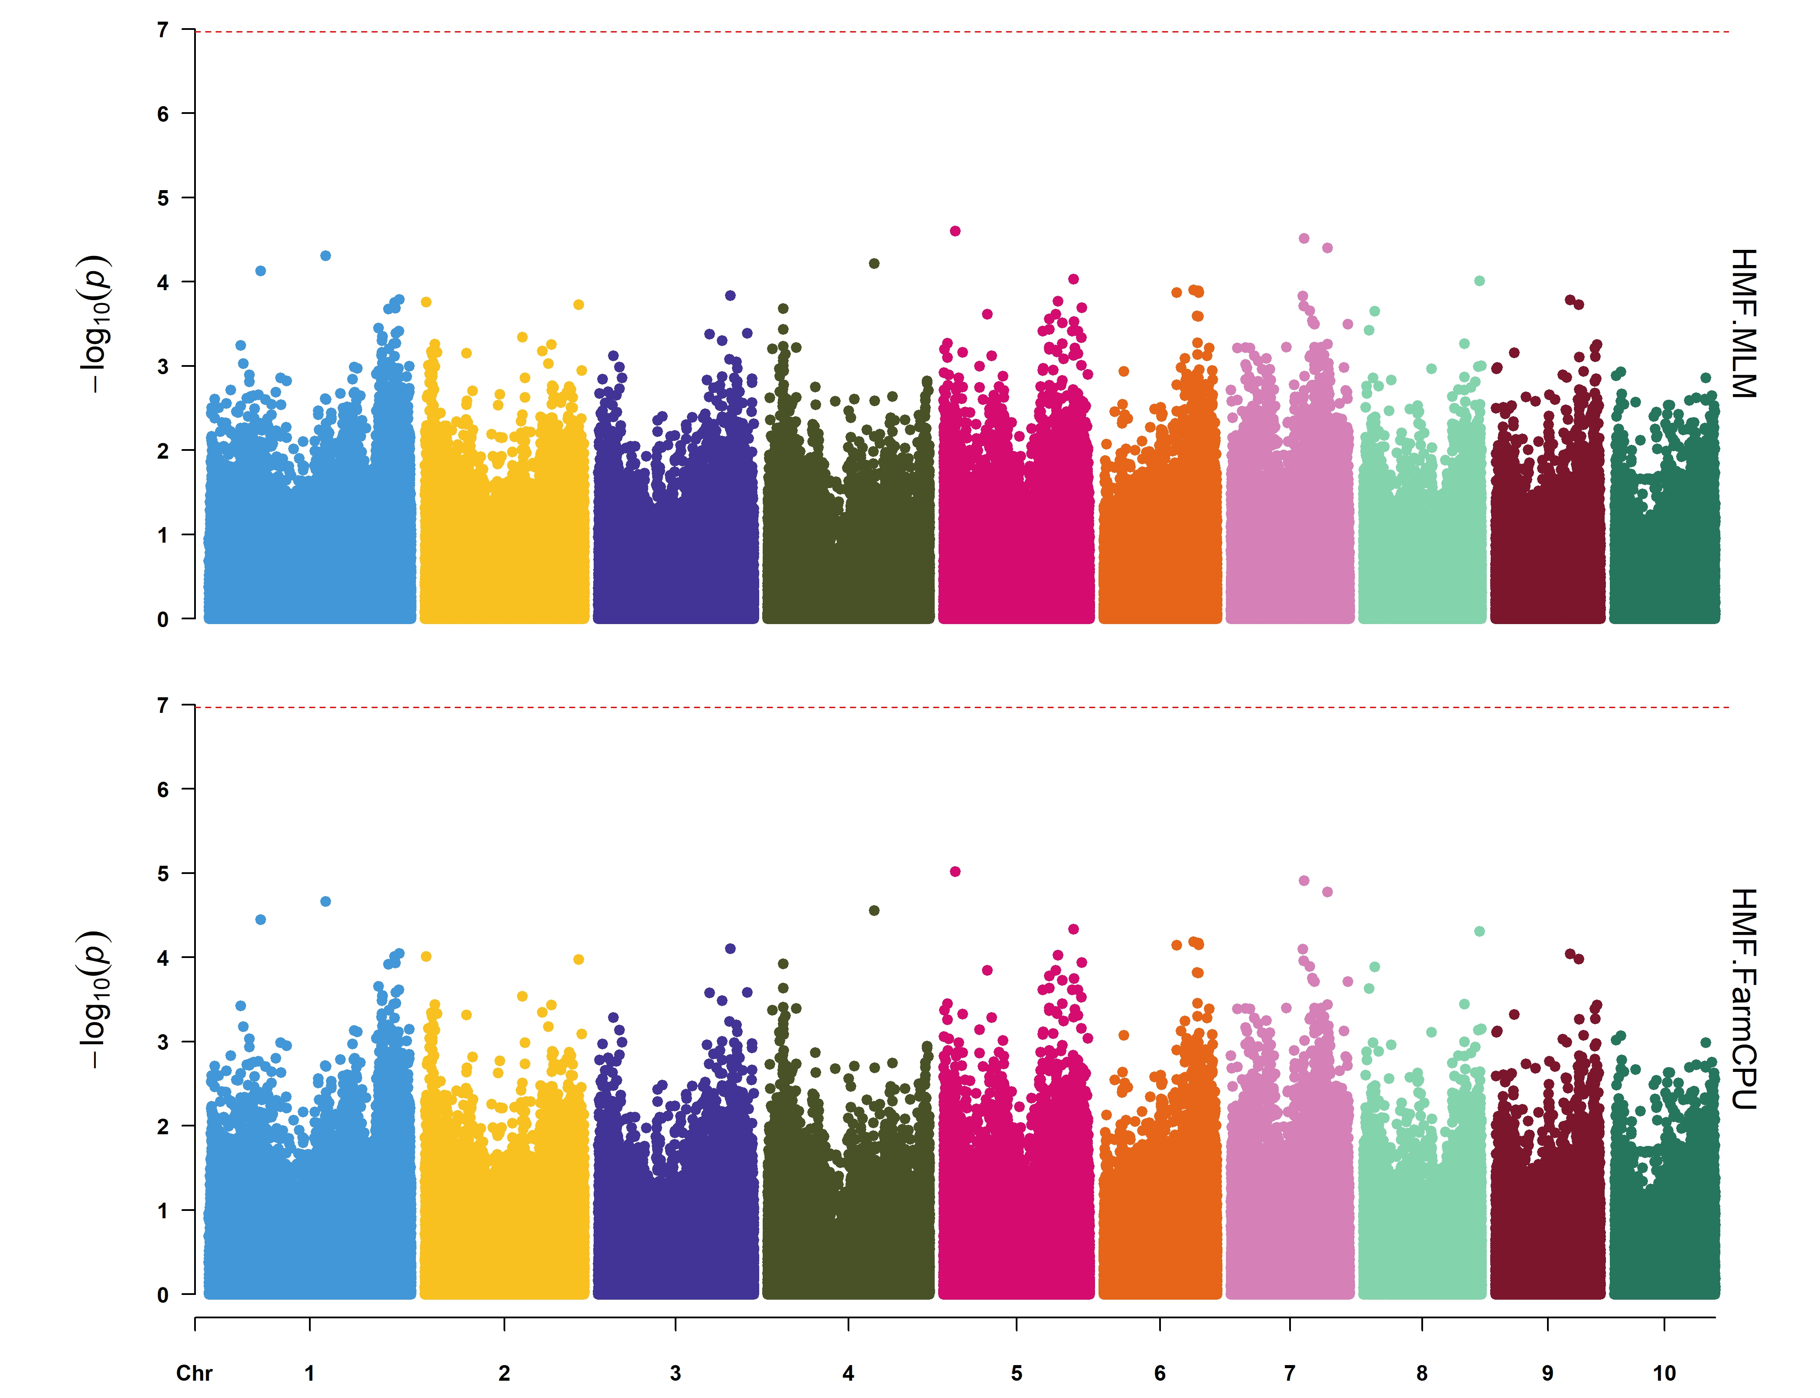
Original paper for HMF vs Our finding
The Manhattan plot shows the most significant SNP in chromosome 1 for HMF.
The Y-axis represents the − log10 P-value and the X-axis represents the chromosomes.
The blue line represents the Simple M-corrected significance threshold

Slide 17
Challenges and Improvements
Status
The README.md contains only a just abstract in the original paper.
The availability document provides phenotype files and GWAS R code—but the code does not run.
Problems Identified
The paper’s R scripts, especially the GAPIT-based GWAS section, fail to execute.
Genotypic data are missing: although the filenames are listed, the files themselves are empty.

Slide 18
Our Solution​
We required the genotypic data from Fakude et al. (2025) to reproduce the paper, in the paper no genotypic data​.
We rewrote the GWAS pipeline using the rMVP package.​
All scripts have been tested under R 4.4.3, since several dependencies are not compatible with newer R versions.

Slide 19
Conclusions
Replication validates GWAS and key SNP associations.
We created a reproducible RMarkdown and GitHub pipeline.
Before this paper, we attempted 2-3 previous studies that did not produce results.
The original code for GWAS did not work, so we made modifications.
There is no genotypic data available, just an empty file. Documentation is essential.
There is a strong overlap with the original paper's findings, but the GWAS results are only partially consistent.

Slide 20
Thank you
Questions?

